Slide 1
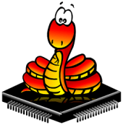
PYTHON FOR MICROCONTROLLERS

Slide 2
What is MicroPython?
MicroPython is a re-implementation of Python 3 targeted for microcontrollers and embedded systems.

Slide 3
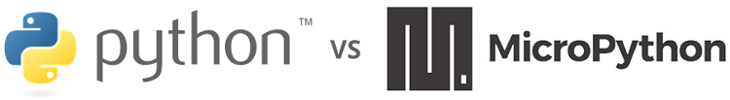
Python vs MicroPython
The biggest difference between Python and MicroPython is that MicroPython was designed to work under constrained conditions.
MicroPython comes with the full standard library along with small subset of the Python standard library.
While python doesn’t include modules to access and interact with the GPIOs, MicroPython does have modules dedicated for GPIO interaction.

Slide 4
Why MicroPython?
It is an Easy-to-learn programming languages ,that can be used to program digital electronics with ease with out prior knowledge of programming.
MicroPython is used by hobbyists, researchers, teachers, educators, and even in commercial products.
MicroPython comes with an interactive REPL (Read-Evaluate-Print Loop). This helps in connecting a board and executing the code without the need to upload or compile code.

Slide 5
MicroPython – Boards support
MicroPython runs on many different devices and boards, such as Pyboard, ESP32 , ESP8266 and STM32 Nucleo boards
In our projects, we’ll use MicroPython with the ESP32 and ESP8266 boards.

Slide 6
Installing Thonny Python IDE
In our workshop we will be considering a Windows PC .
To install Thonny on your Windows PC, follow the next instructions:
1. Go to https://thonny.org
2. Download the version for Windows.
3. Run the .exe file.
4. After completing the installation, open Thonny IDE. A window as shown in the following figure should open.

Slide 7
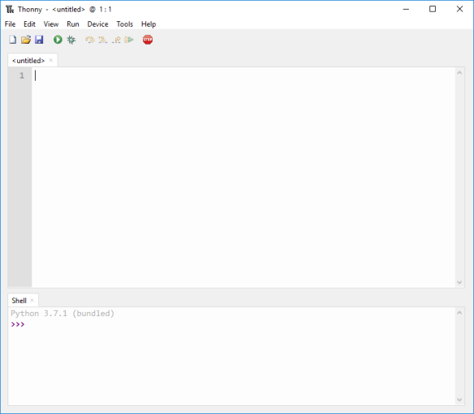

Slide 8
Thonny IDE Overview
There are two different sections on Thonny IDE:
The Editor
The MicroPython Shell/Terminal
The Editor section is where we write code and save as .py files.
On the MicroPython Shell you can type commands to be executed. The shell also provides information about the state of an executing program, shows errors related with upload, syntax errors, prints messages, etc

Slide 9
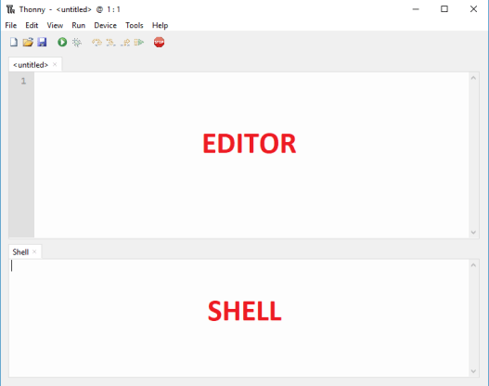

Slide 10
Flashing ESP32/ESP8266 boards with MicroPython firmware
Go to https://micropython.org
Go to downloads and check for the board firmware.
Under Espressif ESP-based boards press Generic 8266 module for Esp8266 and click esp8266-20200911-v1.13.bin (elf, map) (latest) for download
For ESP32 press Generic ESP32 module and click esp32-idf3-20200902-v1.13.bin for download
Go to Tools > Options and select the Interpreter tab.
Choose MicroPython (ESP8266)/ MicroPython (ESP32).
Then, select your device serial port .
Then click Firmware button and upload the firmware.
Now go back and press reset button on your board. The following will be displayed.

Slide 11
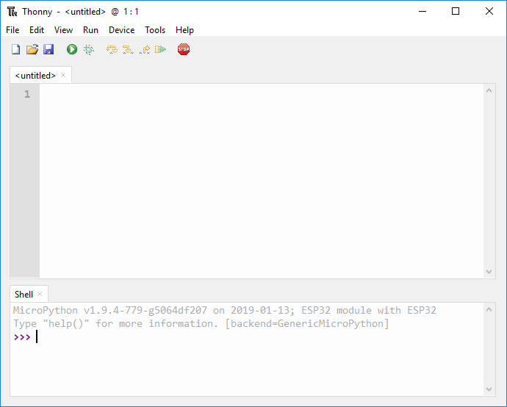

Slide 12
MicroPython Programming Basics for ESP32 and ESP8266

Slide 13
MicroPython programming Basics :
Mathematical operators
Relational operators
Data types
print() function
Conditional statements
While and for loops
User defined functions
Classes and objects
Modules

Slide 14
Mathematical Operators:
MicroPython can perform mathematical operations. The following table shows the mathematical operators supported:
Operator | Mathematical Operation
+ | Addition
– | Subtraction
* | Multiplication
/ | Division
// | Division, discarding the decimal point
% | Remainder after division

Slide 15
Relational Operators:
You can make comparisons using relational operators. These compare the values on either sides and show the relation between them.
Operator | Description
== | Equal to
!= | Not equal to
> | Greater than
< | Less than
>= | Greater than or equal to
<= | Less than or equal to

Slide 16
Assigning Values to Variables:
In Python we don’t need to declare what type each variable is.
Variables are simply a storage placeholder for values: number or text.
To assign a value to a variable you use the equal sign (=), with the variable name on the left and the value on the right.
For example, to create a variable to hold the GPIO number where an LED is connected to, you can simply type the following:
led_pin = 23
In the Arduino IDE, you would have something like:
const int led_pin = 23;
Note: Variables can’t have spaces and are case sensitive, so led_pin is different from LED_PIN or Led_Pin.

Slide 17
Data Types:
Variables can store several types of values, not just whole numbers. That's where data types come in.
A data type is a classification of a value that tells what operations can be done with the value and how it should be stored.
The following table shows the data types:
Data type | Description
int (Int) | Integer (whole number)
float (Float) | Number with a decimal point
str (String) | Set of characters between quotation marks
bool (Boolean) | True or False

Slide 18
print() Function
The print() function prints the message between parentheses into the Shell.
For example:
>>> print('LED is on')LED is on
Comments
Comments in Python start with the hash character (#) and continue to the end of the line.
For example:
# This is just a comment
Note: Because in MicroPython we are working under constrained conditions, there are occasions in which you should avoid adding comments to save space on the ESP memory.

Slide 19
Conditional Statements

Slide 20
Indentation:
With MicroPython, we use indentation.
Additionally, you need to use a colon : after each expression.
This is an alternative, to use of {} curly brackets to define code blocks as in the Arduino IDE.
Important: MicroPython indentation should be only 2 spaces to fit more code into the microcontroller memory when compared to Python’s standard indentation of 4 spaces.

Slide 21
While and For loops:
Loops allows to execute a block of code multiple times for as long as a condition is met. There are two kinds of loops: while and for loops.
while loop:
For example, you can print all numbers from 1 to 10 with a while loop:
number = 1
while number <= 10:
print(number)
number = number + 1
The code is executed as long as the value in the number variable is less than or equal to (<=) 10. In every loop, the current number is printed and then 1 is added to it.

Slide 22
For loop:
One can also print numbers from 1 to 10 using a for loop, like this:
number = 1
for number in range(1, 11):
print(number)
The for loop is executed as long as the value in the number variable is within the range of 1 and 10. The range() function automatically assigns the next value to the number variable, until 1 below the final number you specify.
Important: Similar to the conditional statements, the for and while Boolean expressions should have a colon : right after them, and the expressions to be executed should be indented.

Slide 23
User-defined Functions:
To define a new function, you use the word def followed by the name you want to give the function and a set of parentheses (and arguments inside, if necessary). After the parentheses add a colon : and then tell the function what instructions to perform. The statements should be indented with 2 spaces (in MicroPython).
The format:
def my_function(<arg1>, <arg2>, ...):
<statement>
(...)
return

Slide 24
For example, a function that converts the temperature in Celsius to Fahrenheit could be the following:
def celsius_to_fahrenheit(temp_celsius):
temp_fahrenheit = temp_celsius * (9/5) + 32
return temp_fahrenheit
The celsius_to_fahrenheit() function accepts as argument a temperature in Celsius (temp_celsius). Then, it does the calculation to convert the temperature. Finally, it returns the temperature in Fahrenheit (temp_fahrenheit).
Note: functions don’t necessarily need to return something. They could just perform some work without the need to return anything.

Slide 25
Classes and Objects:
Python is an Object-Oriented Programming (OOP) language.
There are two important concepts you need to understand about OOP:
Classes
Objects

Slide 26
Classe:
A class is a blueprint for objects. It defines a set of attributes (data and functions) that characterize an object.
The functions inside of a class are called methods.
Classes are defined by the keyword class followed by the name of the class.
For example:
class MyClass:
(...)
Note: by convention, classes’ names in Python should be Cap Words. However, you can give whatever name you want.

Slide 27
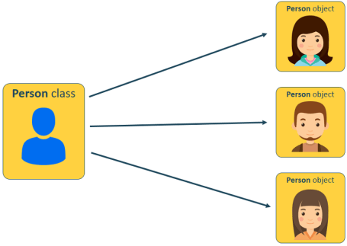
Object:
An object is an instance of a class. It’s simply a collection of data and methods into a single entity.

Slide 28
Example:
class Person:
name = "”
age = 0
country = "”
def description(self):
print("%s is %d years old and he is from %s.” %(self.name, self.age, self.state))
person1 = Person()
person1.name = "Jayaraj VS"
person1.age = 37
person1.state = "Kerala"
person1.description()

Slide 29
The constructor method:
Instead of having to define a class, and then set the object’s properties, which can be time consuming, you can use the constructor method inside your class.
The constructor method is used to initiate data as soon as an object of a class is instantiated.
The constructor method is also known as __init__ method. Using the __init__ method, the Person() class looks as follows:
class Person():
def __init__(self, name, age, country):
self.name = name
self.age = age
self.country = country
def description(self):
print("%s is %d years old and he is from %s." %(self.name, self.age, self.country))
person1 = Person("Jayaraj VS", 37, "Kerala")
person1.description()

Slide 30
Modules:
A module is a file that contains a set of classes and functions you can use in your code – you can also call it library.
To access the classes and functions inside that code, you just need to import that module into your code.
You can create your own modules, or use already created modules from the standard Python library.
When it comes to MicroPython, it only comes with a small subset of the standard Python library, but it does come with a set of modules to control GPIOs, make networks connections and much more.

Slide 31
Importing modules/libraries:
Importing modules/libraries is as simple as using:
import module_name
For example, to import the machine library that contains classes to control GPIOs, type the following:
import machine
In most programs you won’t need all the classes from one module. You may just want to import a single class.
For example, to import only the Pin class from the machine module:
from machine import Pin

Slide 32
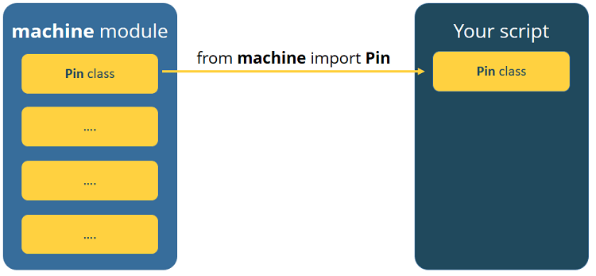

Slide 33
MicroPython Programming in A Nutshell
Let’s just summarize some of the main points of programming in MicroPython:
WE don’t use semicolon ; at the end of a statement like other programming languages.
In conditional statements ,loops and functions we use a colon :
To define code blocks use indentation instead of curly brackets { }
When creating a variable, we don’t need to define which data type it is that means we don’t need to declare a variable
Indentation in MicroPython is 2 spaces

